Slide 1
SALARY SURVEY
ANALYSIS
Presented By
JAMES VASANTHAN R

Slide 2
OBJECTIVE
Compare salary across industries, job titles, and countries
Identify salary variations by gender, experience, and education
Calculate total compensation using SQL queries
Visualize insights using Excel Pivot Tables & Dashboard
TOOL USED
MySQL
Excel
Pivot Charts

Slide 3
ATTRIBUTES:
Age Range
Industry Job Title & Clarification
Annual Salary
Additional Compensation (Bonus, Incentives)
Country, State, City
Years of Overall & Field Experience
Highest Education Level
Gender Currency Details
Dataset stored and analyzed through SQL → exported to Querys.xlsx.

Slide 4
DATA CLEANING
Removed duplicates
Filled missing values (Unknown / Median)
Standardized job titles & countries
Converted salary fields to numeric
Handled inconsistent formats
Treated extreme salary outliers
Exported cleaned dataset for SQL import

Slide 5
SQL TRANSFORMATION
After the cleaning imported the data to SQL was chosen to ensure scalability, automation, and professional grade analysis.
SQL makes it easy to perform aggregations, joins, and filter.
Average Salary by Industry & Gender
Total Compensation by Job Title
Salary Distribution by Education Level
Employee Count by Industry & Experience
Median Salary by Age & Gender
Highest-Paid Job Title by Country

Slide 6
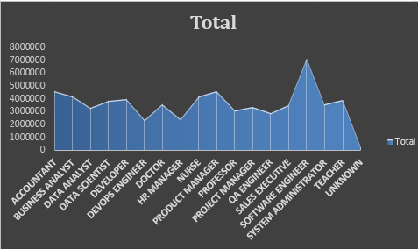
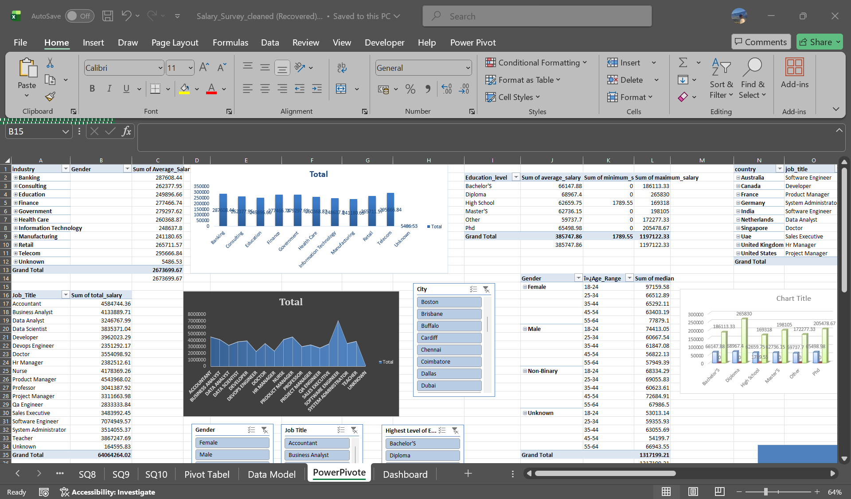
QUERIES AND CHARTS
select industry, Gender, round(avg(Salary_USD),2) AS Average_Salary
from salary_survey group by Industry, gender
order by Industry, gender ;
Select Job_Title, round (sum(Salary_USD),2) as total_salary from salary_surveygroup by Job_Titleorder by Total_Salary desc;

Slide 7
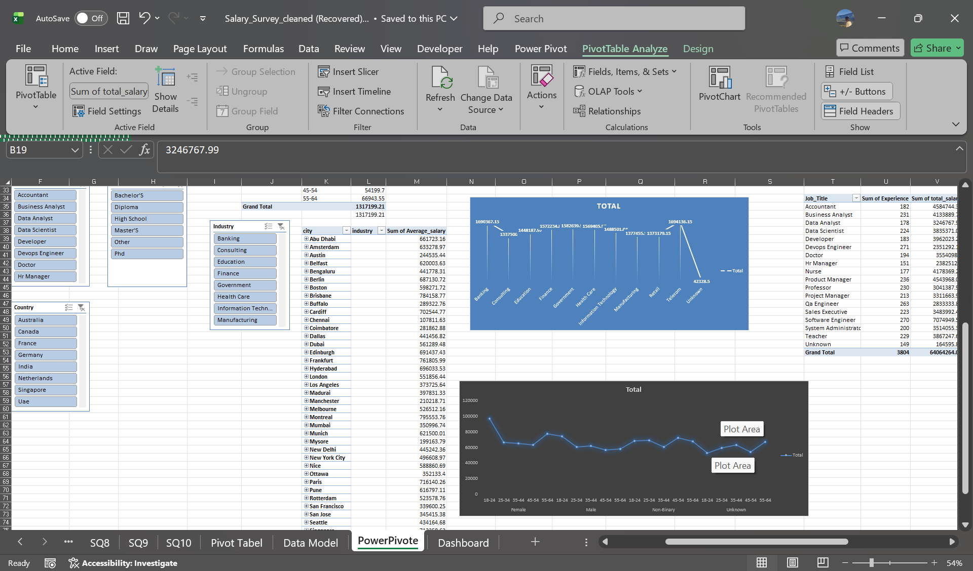
select city, industry, round(avg(salary_usd),2) as Average_salary from salary_survey group by city, industry;
select Gender,ï»¿Age_Range round(avg(salary_usd),2) as median from salary_survey group by Gender,ï»¿Age_Range;

Slide 8
EXPORT TO EXCEL
SQL queries were executed, results exported into excel for visualization.
Power Pivot or Pivot table, charts and slicers are easier to build in excel for Dashboard.
This step bridges technical analysis(SQL) with business- friendly Dashboards.

Slide 9
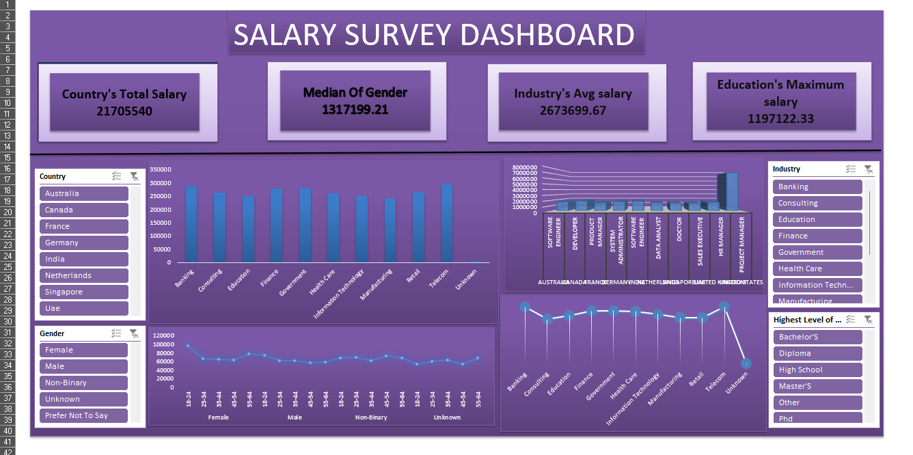
SALARY SURVEY DASHBOARD

Slide 10
DASHBOARD SUMMARY:
Excel Dashboard includes :
Salary by Industry Bar Chart
Gender vs Salary Comparison Chart
Experience vs Salary Line Chart
Salary by Education Level
Top-Paying Job Titles
Country & City-Based Salary Trends
Provides a clear interactive view of salary patterns.

Slide 11
KEY INSIGHTS
Key Insight 1: Salary vs Experience Strong positive correlation between salary and experience Major salary jump between 5–10 years of experience
Growth slows after 15+ years (career plateau)Senior professionals show stable, higher compensation across industries
Key Insight 2 : Education Level Matters Master’s degree holders earn 20–40% more than Bachelor’s PhD professionals have the highest median salary
Skill-heavy roles (Software Engineering) offer high pay without advanced degrees Education is a major driver for salary growth

Slide 12
Key Insight 3: Job Title Hierarchy Senior roles = 30–50% higher compensation
Highest-paying roles : Data Scientist Senior Software EngineerProject Manager Senior Consultant Clear salary progression from
Analyst → Senior → Manager
Key Insight 4: Gender Salary Gap Male employees earn 8–15% more on average Gap is smaller in Education, HR, Health care
Most noticeable in Tech and Finance Bonus/Additional compensation shows similar patterns

Slide 13
RECOMMENDATION & CONCLUSION
Recommendations :
Expand dataset with multi-year data
Standardize currencies & compensation
Collect more detailed job role information
Include skills and certifications in future datasets
Use BI tools for richer dashboards
Apply ML for trend prediction

Slide 14
Conclusion :
Salary is heavily influenced by experience, industry, job title, and education
Gender gaps still exist, varying by industry
Tech & Finance offer highest salary growth opportunities
Higher education delivers strong ROI
Location and company type impact compensation significantly
Overall → The dataset reveals meaningful patterns to guide HR decisions and career planning.

Slide 15
THANK YOU

